Slide 1
The Naive Bayes model is an old method for classification and predictor selection that is enjoying a renaissance because of its simplicity and stability.
https://www.datasciencecentral.com/profiles/blogs/naive-bayes-for-dummies-a-simple-explanation
Posted by Mike Waldron
Feature selection. These are applications in which you choose a subset of predictors from a larger set of variables. Most classification methods do not perform well when there are too many predictors. Since, in practice, many predictors don't contribute to the classification, the preclassification step is to find a subset of predictors that are relevant.
Classification. These are applications in which you use known values of one or more independent variables (or predictors) to estimate the values of a categorical target variable.

Slide 2
The Naive Bayes component is most useful in applications that require feature selection followed by classification—for example:
Creators of anti-spam software need to classify incoming e-mail as spam based upon the content of the message. Determining which words are most useful in classifying spam is an important first step in building the final model.
Direct marketers want to maximize the probability of response to mailings. In order to create a model to classify households as likely or unlikely respondents, they need to discover the fields in the mailing database that are most useful to the classification.
Investigators want to detect fraudulent transactions based upon features in an insurance claims database. Before classifying transactions as fraudulent, they need to determine which features are most important to the classification.

Slide 3
Advantages
It’s relatively simple to understand and build
It’s easily trained, even with a small dataset
It’s fast!
It’s not sensitive to irrelevant features
Disadvantages
It assumes every feature is independent, which isn’t always the case

Slide 4
Bayes theorem:
P(B|A) = P(A∩B)/ P(A)
P(A∩B) = P(A) P(B|A)
P(A|B) = P(A∩B)/ P(B)
P(A∩B) = P(A|B) P(B)
So, P(B|A) = P(A|B) P(B)/ P(A) and P(A|B) = P(B|A) P(A)/P(B)
Suppose a test for Corona is 99% sensitive and 99% specific.
Prevalence of Corona ~ .001
P(Corona|+) = P(+|Corona) P(Corona)/P(+)
but P(+) = P(+ ∩ Corona) + P(+ ∩ Not Corona)
=P(+|Corona)P(Corona) + P(+|Not Corona)P(Not Corona)
=0.99 x 0.001 + 0.01 x 0.999 = 0.01098
So P(Corona|+) = (.99)(.001)/0.01098 = 0.0902
A is known as the proposition and B is the evidence
P(A) represents the prior probability of the proposition
P(B) represents the prior probability of evidence
P(A|B) is called the posterior
P(B|A) is the likelihood

Slide 5
Conditional Independence Assumption:
The gist of conditional independence: Knowing C makes A and B independent.
Examples:
Amount of speeding fine ㅛ Type of car | Speed
Lung cancer ㅛ Yellow teeth | Smoking
Child’s genes ㅛ Grandparents’ genes | Parents’ genes

Slide 6
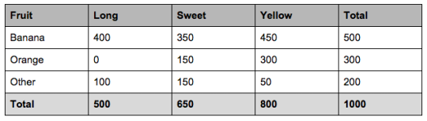
Have data on 1000 pieces of fruit. Data on 3 features.
50% of the fruits are bananas
30% are oranges
20% are other fruits
From 500 bananas 400 (0.8) are Long, 350 (0.7) are Sweet and 450 (0.9) are Yellow
Out of 300 oranges 0 are Long, 150 (0.5) are Sweet and 300 (1) are Yellow
From the remaining 200 fruits, 100 (0.5) are Long, 150 (0.75) are Sweet and 50 (0.25) are Yellow

Slide 7
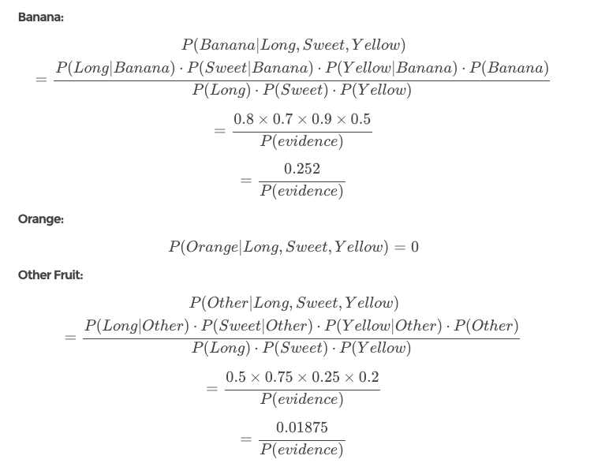
So let’s say we’re given the features of a piece of fruit and we need to predict the class. If we’re told that the additional fruit is Long, Sweet and Yellow.
P(A|B) = P(B|A) P(A)/P(B)
Conditional Independence assumption
In this case, based on the higher score
0.01875 < 0.252
we can assume this Long, Sweet and Yellow fruit is, in fact, a Banana.

Slide 10
The final equation comes down to:

Slide 11
See NaiveBayesExample1R_Out.pdf

